Slide 1
Direct Numerical Simulation of Compressible Turbulent Flows with Weighted Non-Linear Compact Schemes
Alfred Gessow Rotorcraft Center Aerospace Engineering Department University of Maryland, College Park
Debojyoti Ghosh
Graduate Research Assistant
Shivaji Medida
Graduate Research Assistant
James D. Baeder
Associate Professor
65th Annual Meeting of the APS Division of Fluid Dynamics
November 18 – 20, 2012, San Diego, CA

Slide 2
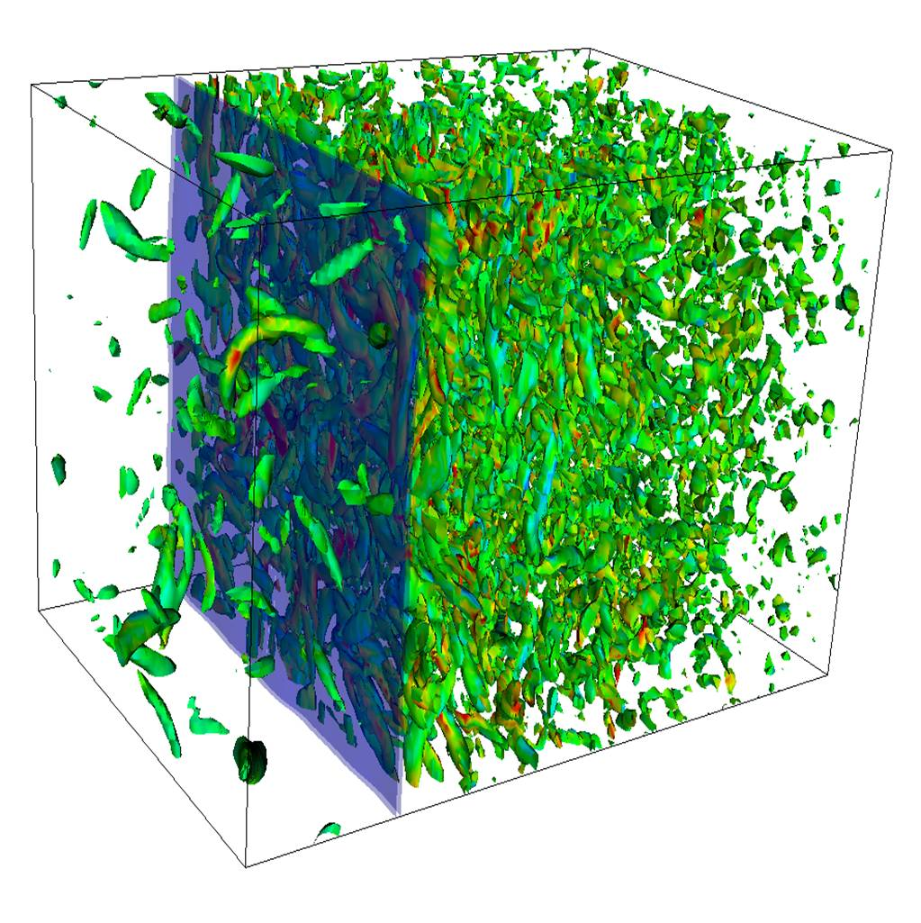
Motivation
Numerical Solution of Compressible Turbulent Flows
Aircraft and Rotorcraft wake flows
Characterized by large range of length scales
Convection and interaction of eddies
Compressibility → Shock waves & Shocklets
Thin shear layers → High gradients in flow
High order accurate Navier-Stokes solver
High spectral resolution for accurate capturing of smaller length scales
Non-oscillatory solution across shock waves and shear layers
Low dissipation and dispersion errors for preservation of flow structures
Shock – Turbulence interaction
http://shocks.stanford.edu/shock_turbulence.html

Slide 3
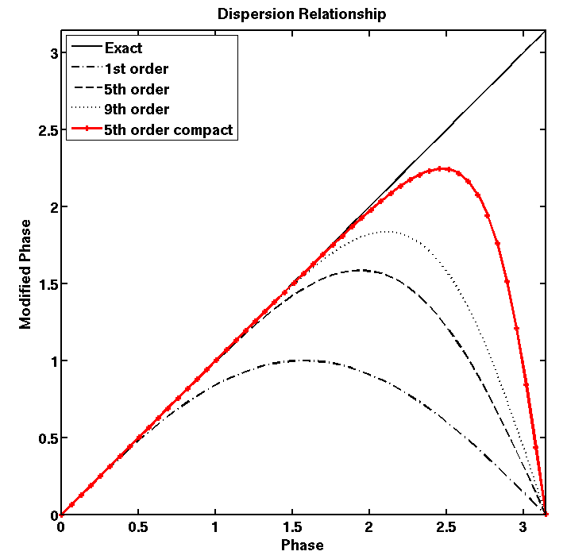
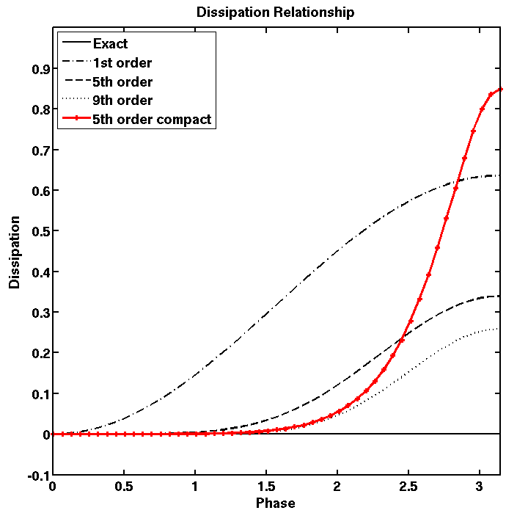
Compact-Reconstruction WENO Schemes
The Compact-Reconstruction WENO (CRWENO)★ scheme
Convex combination of r-th order candidate compact interpolations
Optimal weights in smooth regions → (2r-1)-th order compact interpolation
Smoothness - dependent weights → Non-oscillatory interpolation for discontinuities
Smoothness Indicators
Optimal Weights
WENO Weights
Interface flux
Candidate compact stencils
Why Compact Reconstruction?
High order accuracy with smaller stencils
Better spectral resolution than explicit interpolation (bandwidth resolving efficiency)
Lower dissipation at resolved frequencies
Taylor series error order of magnitude lower
Dispersion and dissipation relationships
★ Ghosh & Baeder, SIAM J. Sci. Comp., 34(3), 2012

Slide 4
5th Order CRWENO scheme

Slide 5
Non-Linear Weights
Weights are calculated based on smoothness indicators of corresponding explicit stencils (same as WENO5 scheme)
Various Implementations of WENO weights:
Jiang & Shu (1996) → CRWENO5-JS
Henrick, Aslam & Powers (2005) → CRWENO5-M
Borges, et. al. (2008) → CRWENO5-Z
Yamaleev & Carpenter (2009) → CRWENO5-YC

Slide 6
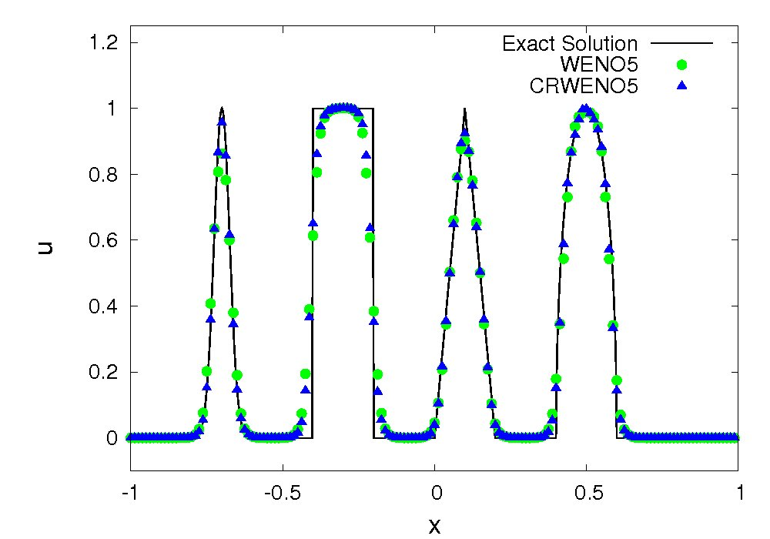
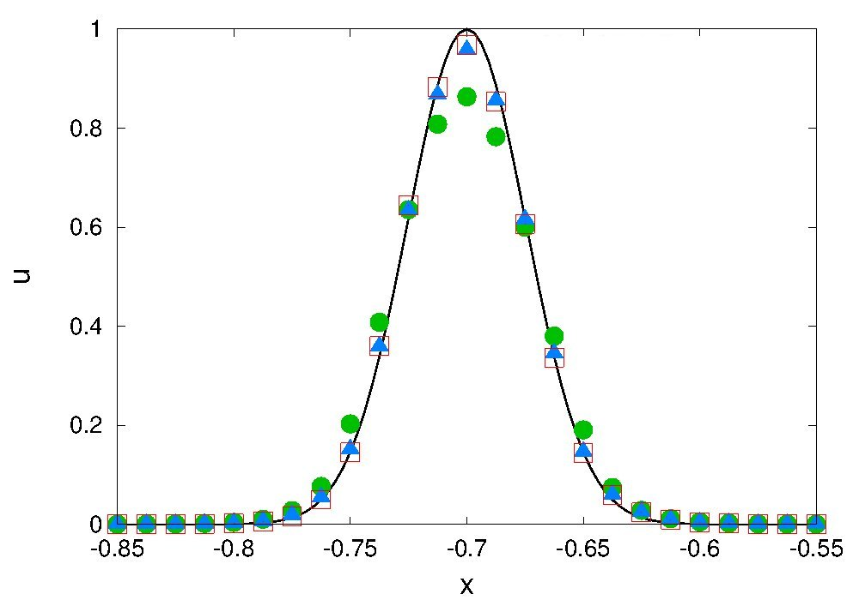
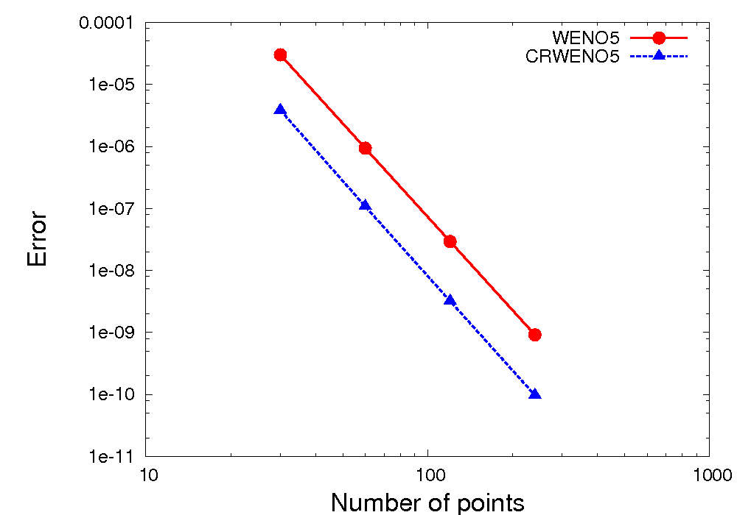
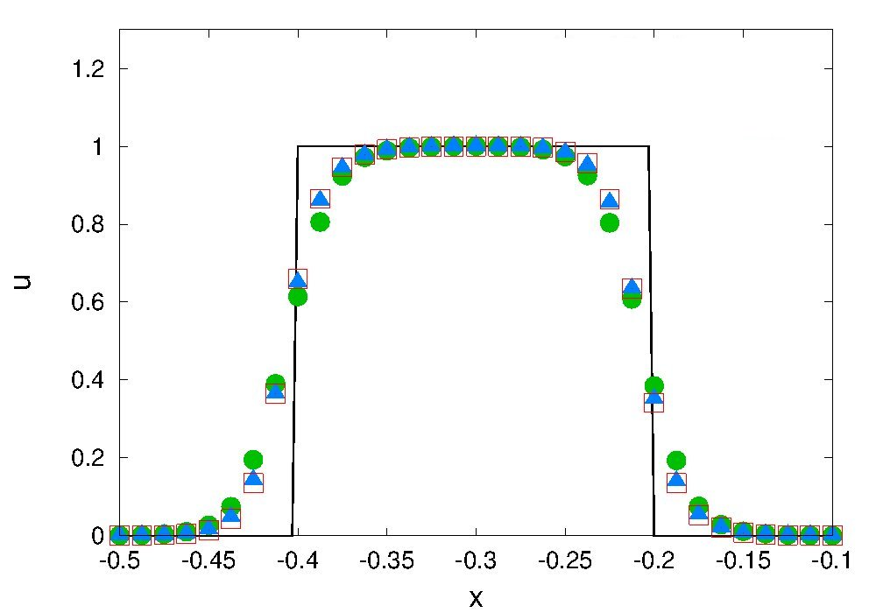
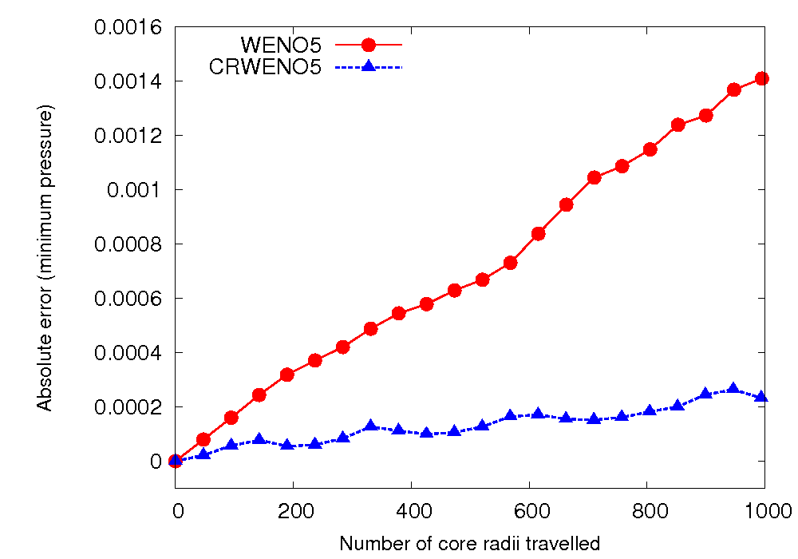
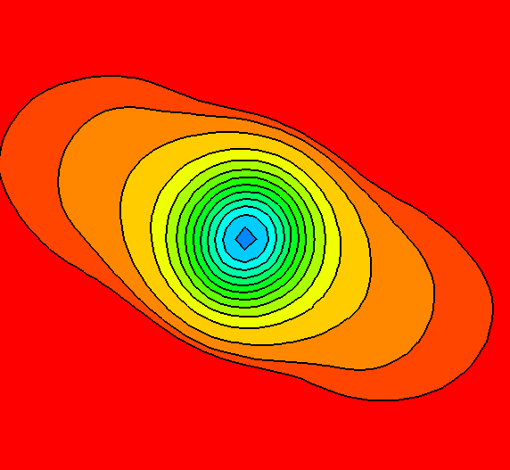
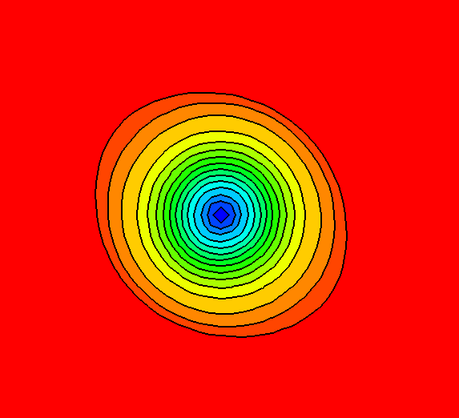
Numerical Properties
Accuracy and convergence
Resolution of discontinuities
CRWENO5 yields significantly lower errors than WENO5
Reduced clipping and smearing of discontinuities
Preservation of flow features
WENO5
CRWENO5
Isentropic vortex convection over large distances

Slide 7
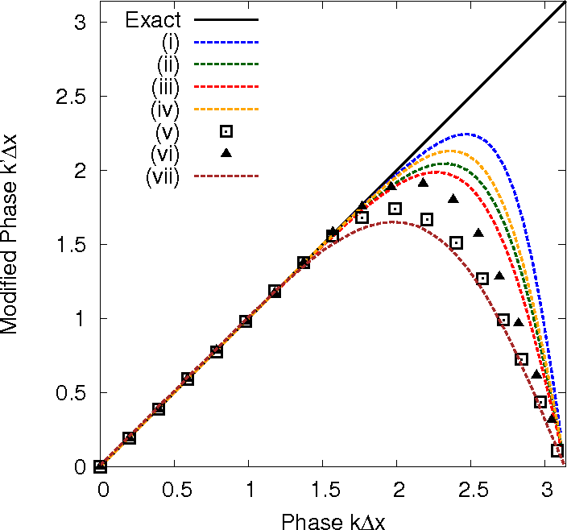
Comparison of Spectral Resolutions
Comparison of spectral resolution and bandwidth resolving efficiency – CRWENO5 scheme with high-resolution schemes in literature
Bandwidth Resolving Efficiency
WENO5(Jiang & Shu, 1996) | 0.35
WENO7 (Balsara & Shu, 2000) | 0.42
WENO9 (Balsara & Shu, 2000) | 0.48
CRWENO5 | 0.61
CRWENO5 (Low dissipation variant) | 0.52
6th-order central compact (Lele, 1992) | 0.50
8th-order central compact (Lele, 1992) | 0.58
WENO-SYMBO (r = 3) (Martin, et. al., 2006) | 0.49
WENO-SYMBO (r = 4) (Martin, et. al., 2006) | 0.56
CRWENO5
CRWENO5 (Low dissipation variant)
6th order central compact (Lele, 1992)
8th order central compact (Lele, 1992)
WENO-SYMBO (r=3) (Martin, et. al., 2006)
WENO-SYMBO (r=4) (Martin, et. al., 2006)
WCNS5 (Deng & Zhang, 2000)

Slide 8
Application to Euler/ Navier-Stokes Equations
Time Marching: 3rd order Total Variation Diminishing Runge Kutta
Spatial reconstruction:
5th order CRWENO scheme (compact)
5th order WENO scheme (non-compact)
Upwinding: Roe’s flux differencing
Viscous Terms discretized by 2nd order central differences
Applications → Problems representative of compressible, turbulent flows:
Shock – entropy wave interaction (1D)
Shock – Vorticity wave interaction (2D)
Decay of isotropic turbulence
Shock – turbulence interaction

Slide 9
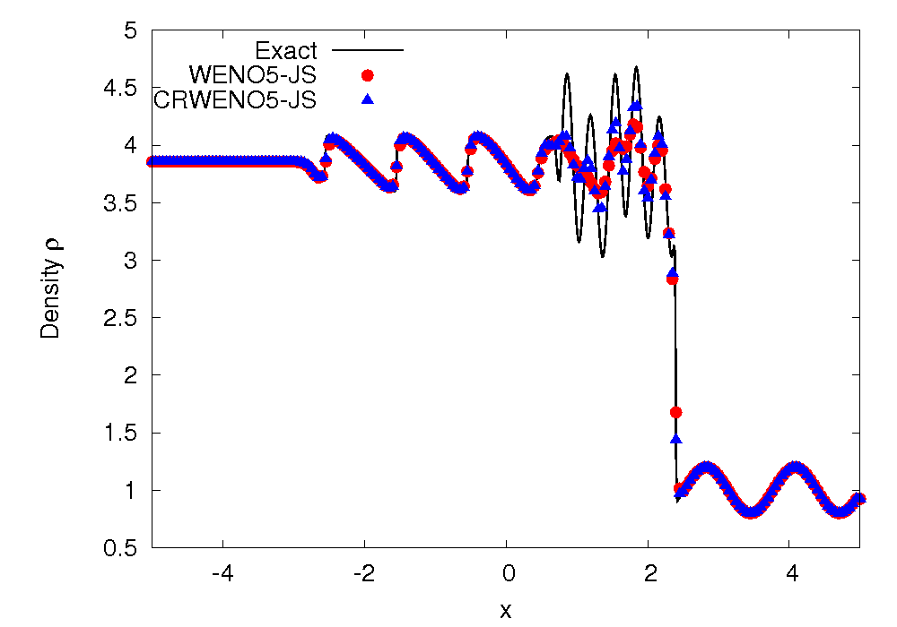
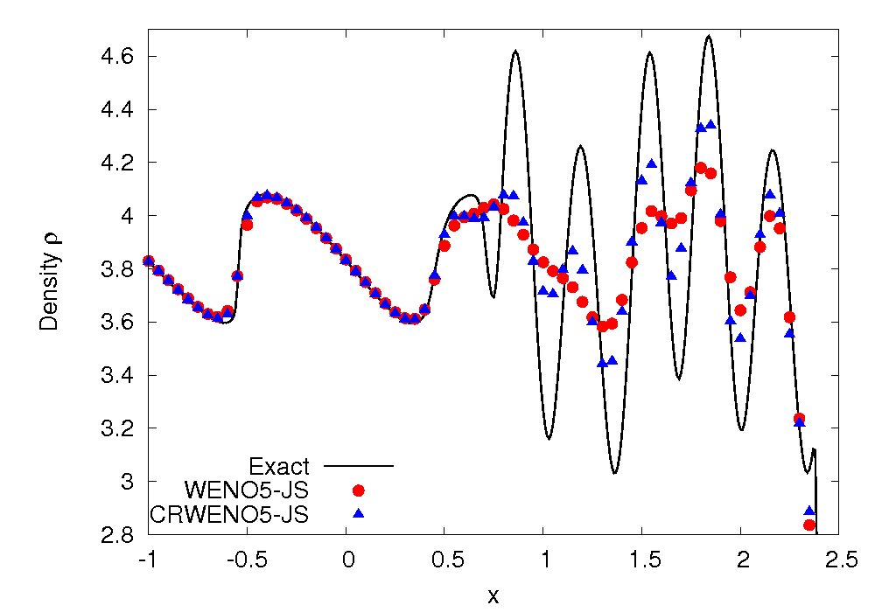
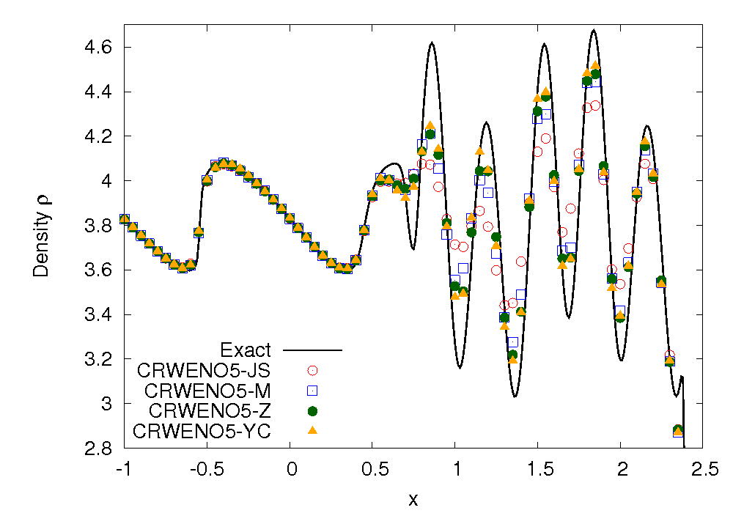
Shock – Entropy Interaction (1D)
6 points per wavelength
Interaction of a shock wave with a density wave resulting in high-frequency waves and discontinuities
CRWENO scheme shows better resolution of high-resolution waves than WENO5
Further improvement by using the alternative formulations for the WENO weights
ε = 10⁻⁶, p = 1

Slide 10
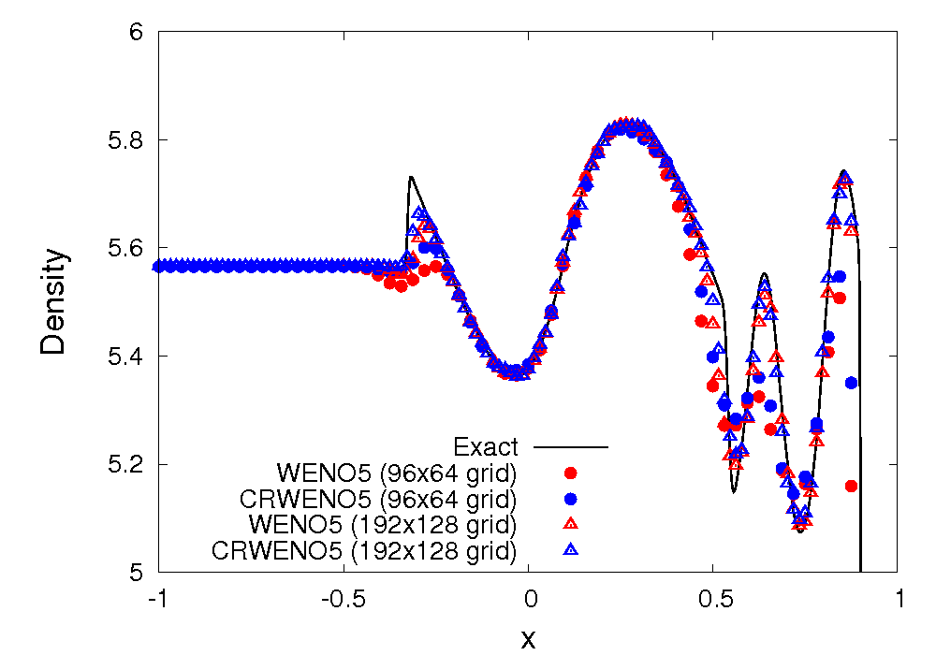
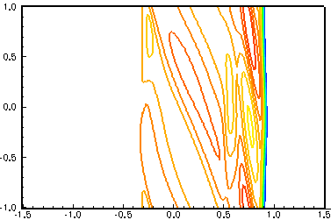
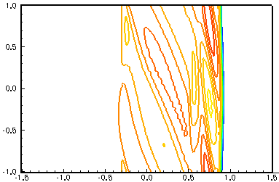
Shock – Vorticity Interaction (2D)
θ = π/6
(Angle of vorticity wave)
WENO5 (192x128 grid)
Interaction of a shock with a vorticity wave:
Accurate capturing of acoustic, vorticity and entropy waves
Solutions obtained on 96x64 and 192x128 grids
CRWENO5 shows reduced clipping of the waves at both grid resolutions
CRWENO5 (192x128 grid)
WENO5 (960x640 grid) (“Exact”)

Slide 11
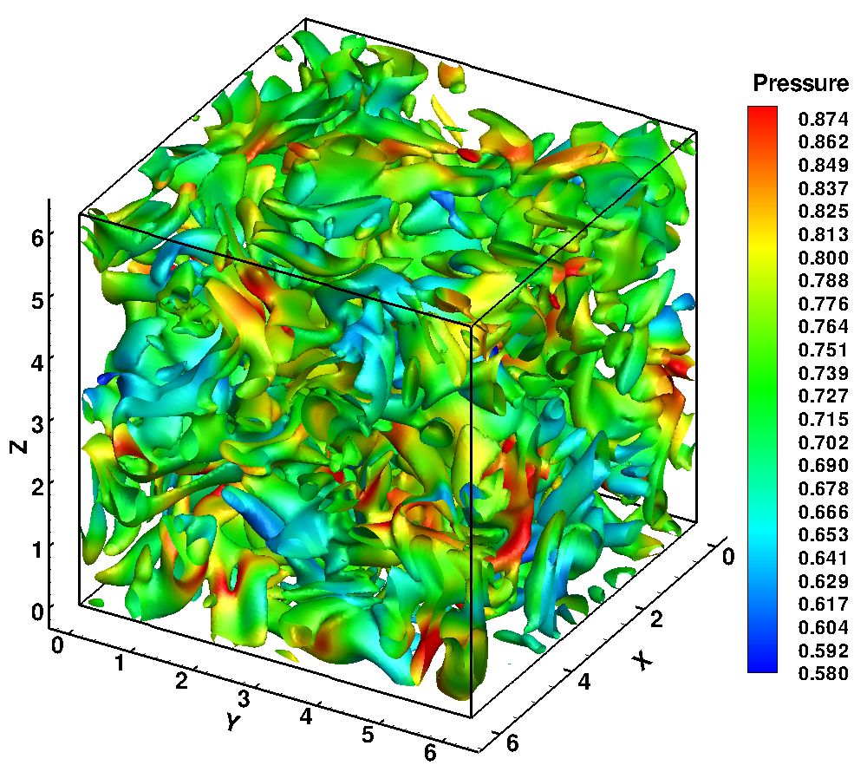
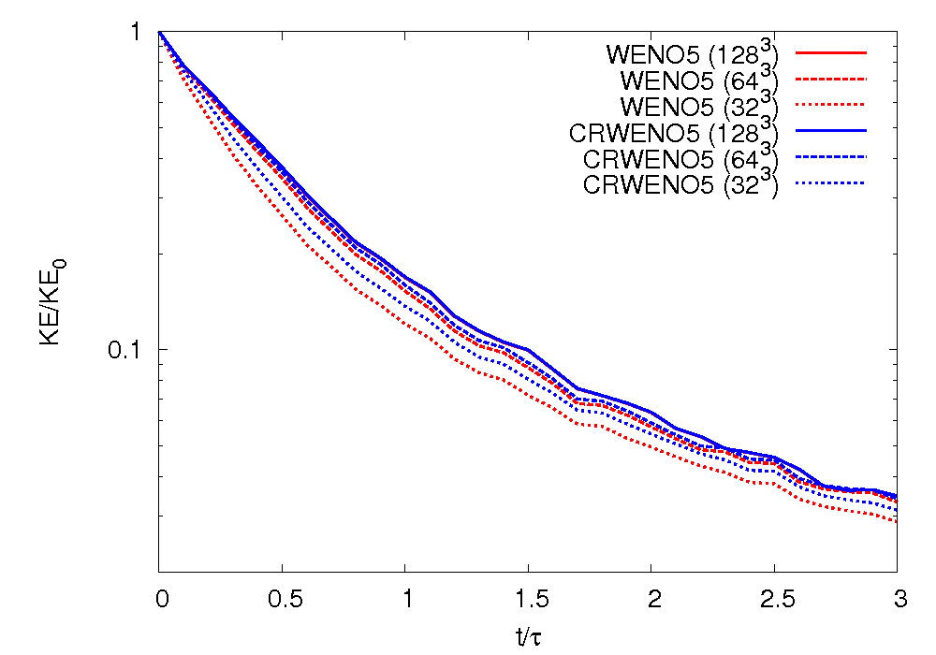
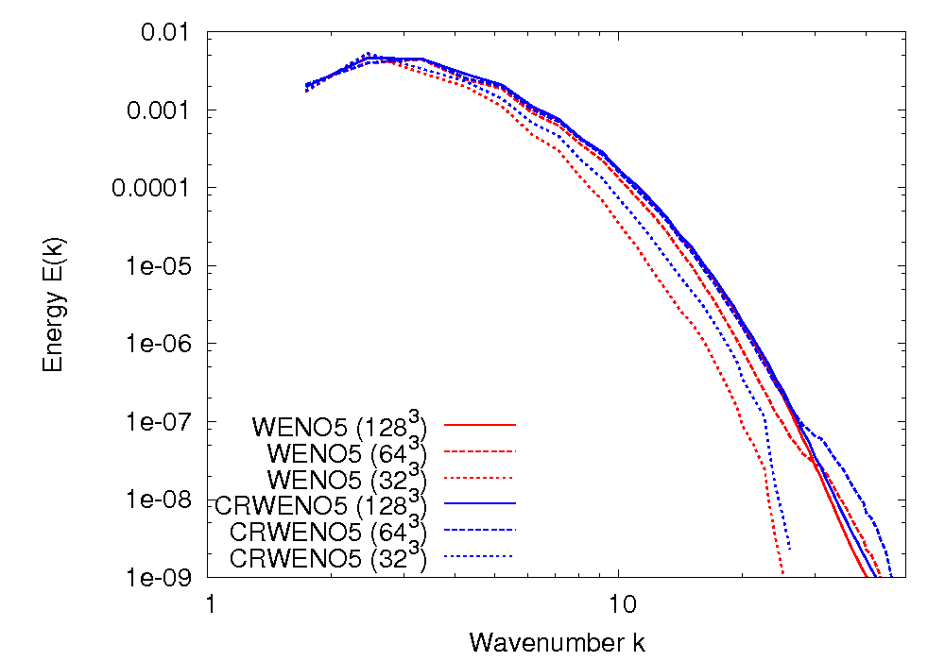
Decay of Isotropic Turbulence
M_{t} = 0.3 Re_{λ} = 50
Iso-surfaces of vorticity magnitude, colored by pressure
t/τ = 1
Flow involves energy transfer to smaller length scales
Grid-converged solutions obtained on 128³ grid (WENO5 & CRWENO5 agree)
CRWENO5 shows better resolution of intermediate and higher wavenumbers

Slide 12
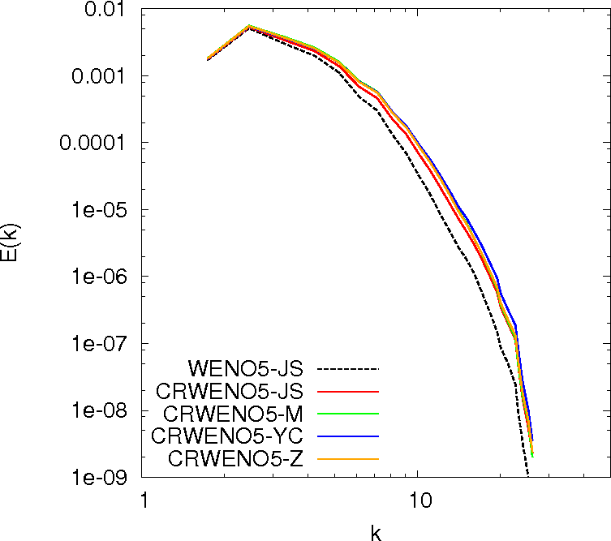
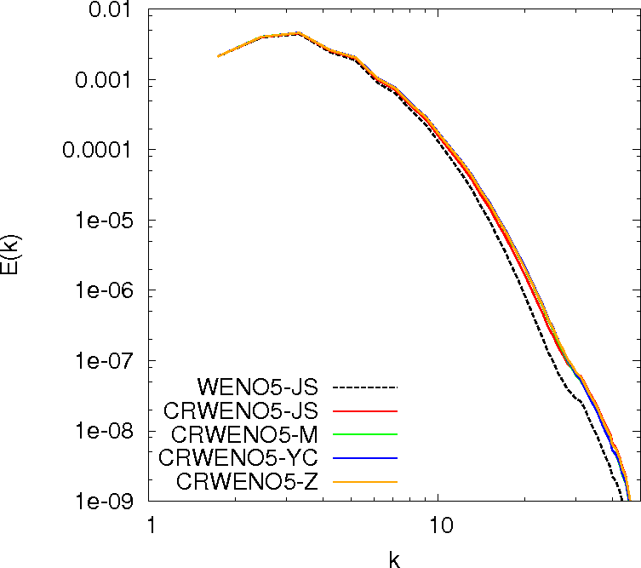
Decay of Isotropic Turbulence
32³ grid
64³ grid
Alternative formulations for the WENO weights result in slight improvements

Slide 13
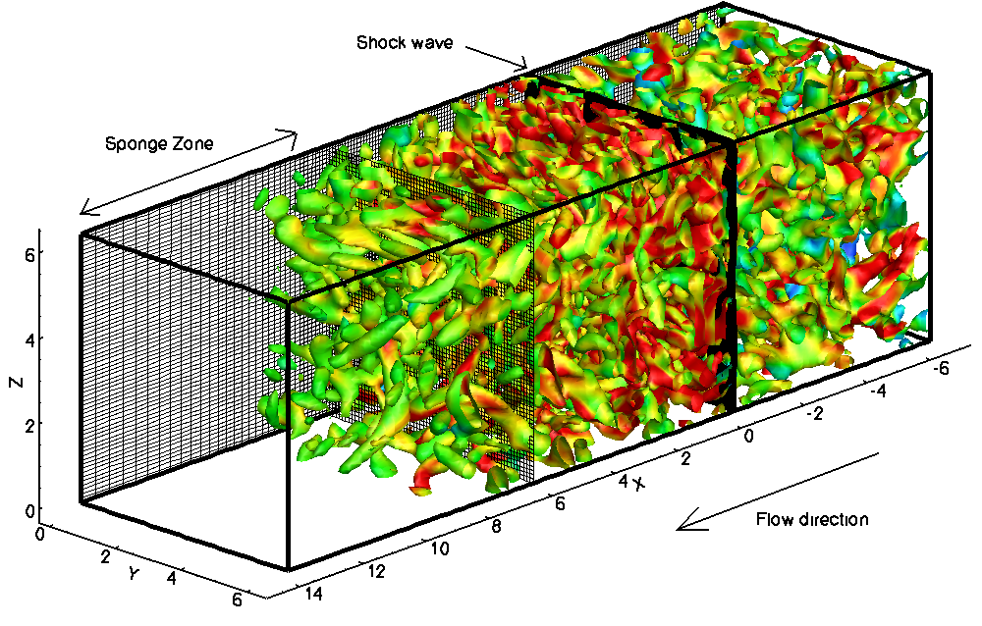
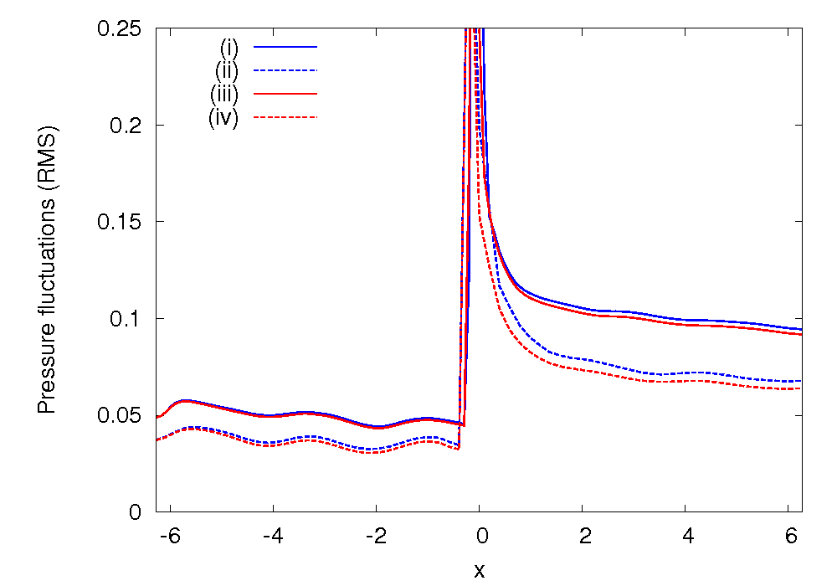
Shock – Turbulence Interaction
M_{t} = 0.3 Re_{λ} = 50
Post-shock
Pre-shock
Iso-surfaces of 2nd invariant of velocity tensor, colored by vorticity magnitude
Stream-wise pressure fluctuations (RMS)
Inflow: Fluctuations from isotropic turbulence decay added to mean flow at Mach 2
Interaction with a shock wave magnifies the turbulent fluctuations
Problem solved on two grids: 64x32x32 and 128x64x64 points (uniform)
CRWENO5 → Lower dissipation → Predicts higher levels of fluctuations on both grids

Slide 14
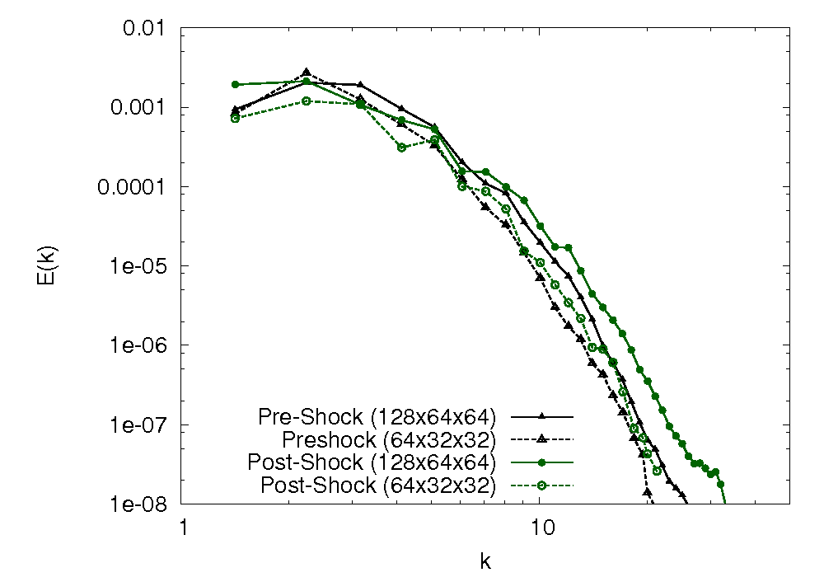
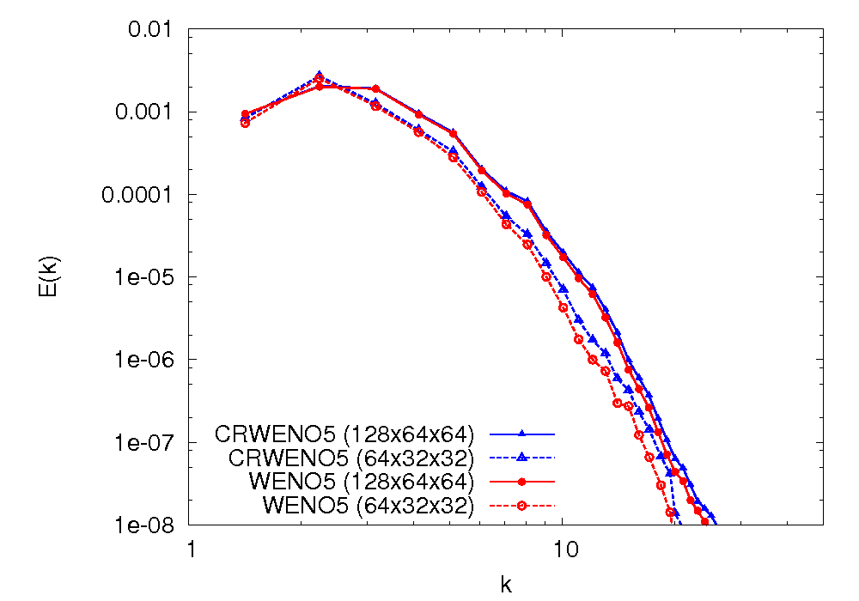
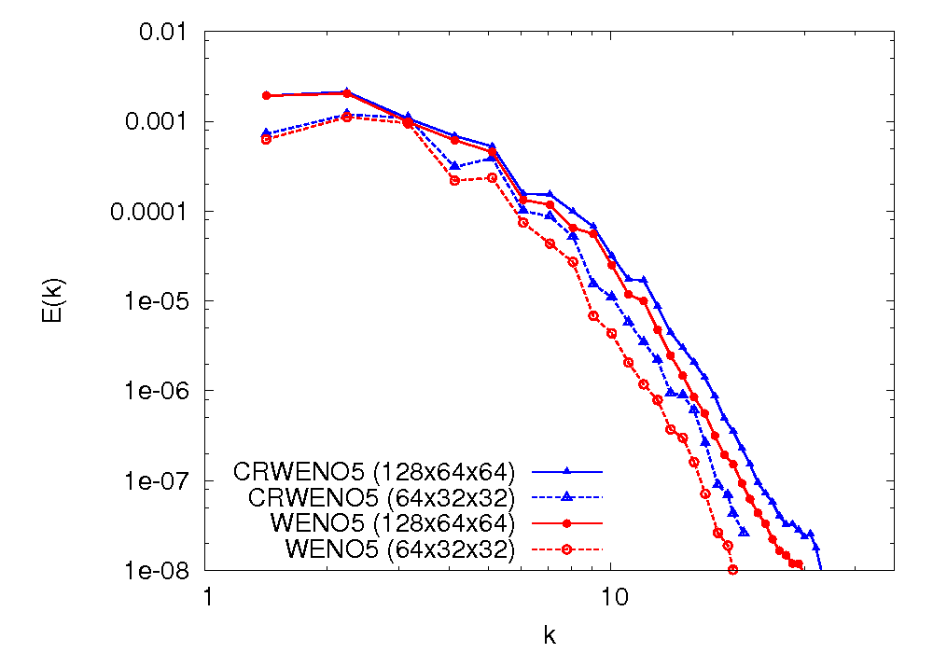
Shock – Turbulence Interaction
Pre-shock
x = -1
Post-shock
Pre- and post-shock energy spectra (CRWENO5)
x = 6
Interaction with a shock wave amplifies intermediate and higher wavenumbers
CRWENO5 shows improved resolution of the smaller length scales (for both grids)

Slide 15
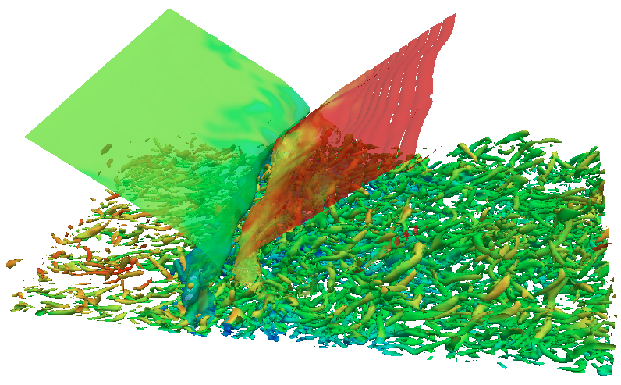
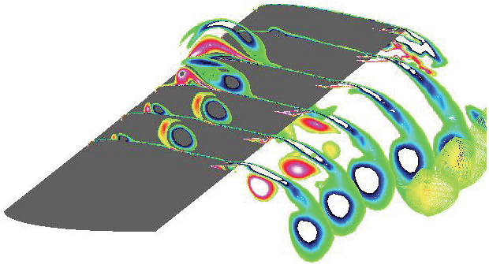
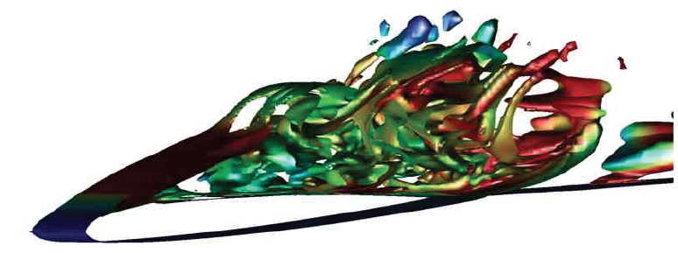
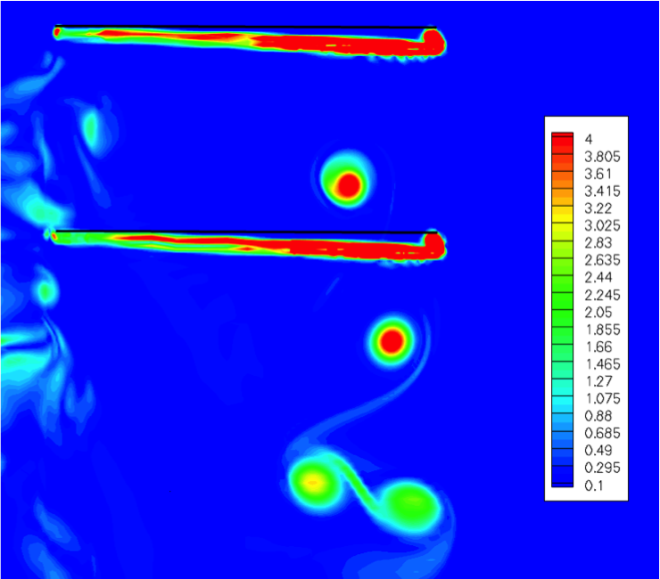
Conclusions and Future Work
Application of CRWENO5 scheme to DNS of turbulent flows
Higher spectral resolution than the WENO schemes (Jiang & Shu formulation, as well as modified formulations)
Lower dissipation at high small and intermediate length scales
Non-oscillatory across discontinuities → Does not require shock-fitting or hybrid compact-WENO techniques
Future Work
DNS of shock – turbulent boundary layer interactions
Unsteady flow around airfoils and wings
High – resolution solutions to aircraft / rotorcraft wake flow and interaction with ground plane

Slide 16
Acknowledgments
This research was supported by the U.S. Army's MAST CTA Center for Microsystem Mechanics with Mr. Chris Kroninger (ARL-VTD) as Technical Monitor.
http://www.mast-cta.org/

